Slide 1
Sensor Data
https://data.mendeley.com/datasets/hkn2tbcp67/1#file-33bf5e41-a783-4c21-b68f-8f621d63c61d
Scott Tan
4/8/2019

Slide 2
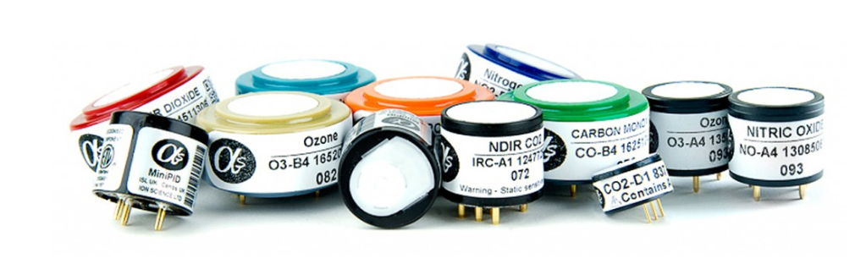
Cheaper sensors
http://www.alphasense.com/index.php/air/products/
Alphasense B4 series
% 5 native gas sensors to use as ytrain
CH4 = table2array(PrimaryUPod(1613:4305,20));
CO = table2array(PrimaryUPod(1613:4305,21));
O3 = table2array(PrimaryUPod(1613:4305,22));
NO2 = table2array(PrimaryUPod(1613:4305,23));
CO2 = table2array(PrimaryUPod(1613:4305,24));

Slide 3
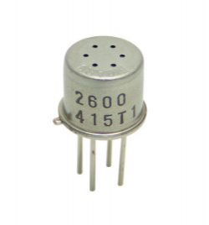
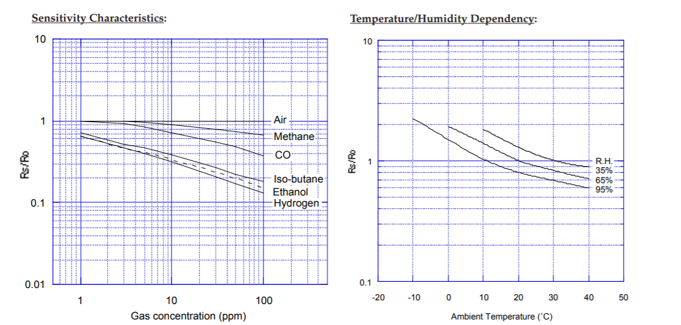
VOC sensor: Figaro 2600
voltage
days
VOC = table2array(PrimaryUPod(1613:4305,4));
http://www.figarosensor.com/product/docs/TGS2600B00%20%280913%29.pdf

Slide 4
Supplemental

Slide 5
Individual gas sensor raw data
acetaldehyde = ydata(:,1);
benzene = ydata(:,2);
c8 = ydata(:,3);
c9 = ydata(:,4);
formaldehyde = ydata(:,5);
methanol = ydata(:,6);
toluene = ydata(:,7);
ppbv
days
The electricity went out for a few days

Slide 6
Training data: Gas sensors from day 10-20
ppbv
ppbv
days
days

Slide 7
Aside: Can we extrapolate this missing data?
acetaldehyde = ydata(:,1);
benzene = ydata(:,2);
c8 = ydata(:,3);
c9 = ydata(:,4);
formaldehyde = ydata(:,5);
methanol = ydata(:,6);
toluene = ydata(:,7);
ppbv
days

